Slide 1



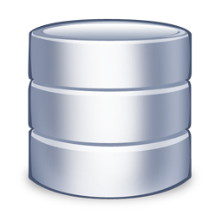

Introduction to SQL Server
Telerik School Academy
Telerik Software Academy
http://academy.telerik.com

Slide 2


Table of Contents
SQL Server
SQL Server Services
Types of Databases
Authentication and Permissions
SQL Server Management Studio
Moving a SQL Server Database
Through Backups and Restore
By Detaching and Attaching

Slide 3

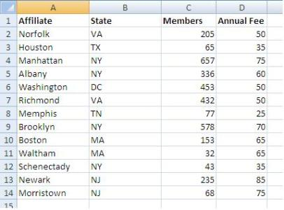

MS SQL Server
Overview

Slide 4
What is Microsoft SQL Server?
MS SQL Server is a Relational Database Management System (RDBMS) from Microsoft
The main language supported in SQL Server is Transact SQL (T-SQL), an extension of SQL
Powerful, trustworthy, easy-to-use DB server
The most recent version is SQL Server 2014
Works only on Windows systems
A free distribution exists (SQL Server Express)
http://www.microsoft.com/express/database/

Slide 5
Services of SQL Server
SQL Server – the database engine
Responsible for database management, data storage, queries, data manipulation, data integrity, transactions, locking, users, security
Executes SQL / T-SQL queries
SQL Server Agent – DB monitoring
Executes scheduled tasks
Monitors SQL Server
Sends notifications about problems

Slide 6





SQL Server Databases
Northwind
msdb
tempdb
msdb

Slide 7
SQL Server Databases
SQL Server has system and user databases
System databases
Maintain internal information about MS SQL Server as a system
Don't play with them!
User databases
Databases created by users (developers)
Store user's schemas and data
Use the system databases internally

Slide 8


Types of SQL Server Databases
System Databases
master
model
tempdb
msdb
distribution
pubs
Northwind
…
User Databases

Slide 9
System Databases
Master – meta-database keeping data about
User accounts
Configurable environment variables
System error messages
Model – a prototype for new databases
Tempdb – storage for temporary tables and database objects
MSdb – alerts and scheduled tasks

Slide 10
SQL Server Databases
Each SQL Server database consists of two files:
.mdf file
Contains the core data in the database
Schema, tables data, and other database objects
.ldf file
Transaction log – keeps track of transactions
You need both these files to use the database

Slide 11


SQL Server Authentication

Slide 12
Connecting to SQL Server
Connecting to SQL Server requires
The name of the server (e.g. localhost)
The name of the DB instance (e.g. SQLEXPRESS)
The name of the database (e.g. Northwind)
Username / password (if using SQL Server authentication)
Types of authentication in SQL Server
Windows (by using a Windows user credentials)
Mixed (both Windows and SQL Server)

Slide 13
SQL Server Users Permissions
Each user has certain permissions and roles for a database (Database User Account)
A role defines a group of users with the same permissions
There are 3 types of roles in MS SQL Server
Fixed server roles
Fixed database roles
User-defined database roles

Slide 14
Fixed Database Roles
Public – maintains all default permissions for users in a database
Db_owner – performs any database role activity
Db_accessadmin – add or remove database users, groups, and roles
Db_ddladmin – add, modify, or drop database objects
Db_securityadmin – assign statement and object permissions
Others…

Slide 15
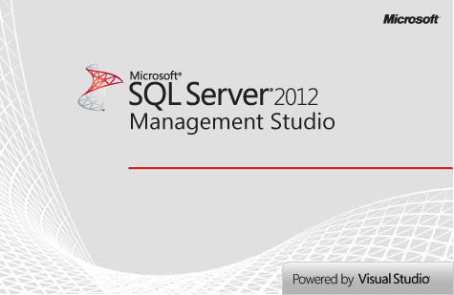


SQL Server Management Studio
A Powerful Management Tool for Administrators and Developers

Slide 16
SQL Server Management Studio (SSMS)
SQL Server Management Studio (SSMS) is a powerful graphical DB management tool
Administrate databases (create, modify, backup / restore DB)
Create and modify E/R diagrams
View / modify table data and other DB objects
Execute SQL queries
Free and easy to use tool
Works with all SQL Server versions

Slide 17
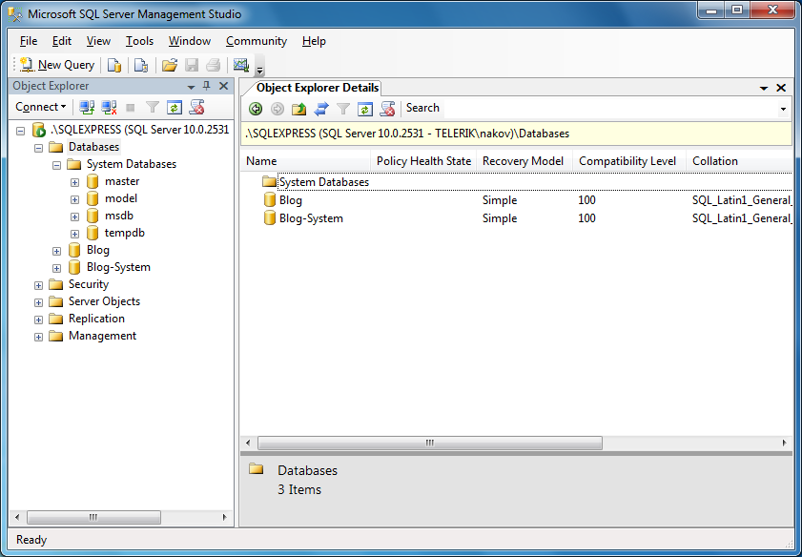
SQL Server Management Studio – Screenshot

Slide 18
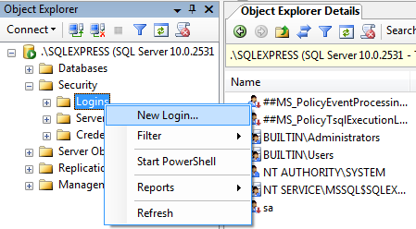
SSMS Setting Server Account
You can use SSMS to create database user / give permissions to Windows users
Follow these steps:
Right click on the [Security / Login] folder in Object Explorer and choose "New Login…"

Slide 19
SSMS Setting Server Account (2)
In the next dialog click the [Search] button
Select one of the Windows accounts in a typical Windows fashion
Leave the authentication method set to Windows authentication
Click [OK]
Thus you create an SQL Server User account
Account permissions could be assigned later
Windows administrators already have access

Slide 20
SSMS Setting Database Account
Right click on the "Security" under some of the databases and choose "New" → "User"
Enter username and select one of the Server accounts to use
Assign the roles for this user
Click [OK] to confirm
By selecting the [Name-of-Database] → "Properties" → "Permissions" you can also set specific permissions for the accounts

Slide 21

Creating Accounts and Assigning Permissions in SQL Server
Live Demo

Slide 22
Using SQL Server Management Studio
SSMS can be used to visually edit the structure or data in a database
It can execute T-SQL queries
Select the database you want to work with in the Object Explorer
Click the [New Query] button
Write the query in the window to the right of Object Explorer
Click the [Execute] button

Slide 23
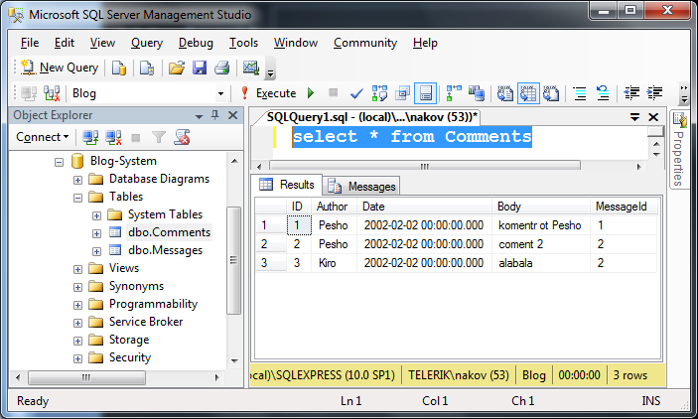
Executing SQL – Screenshot

Slide 24
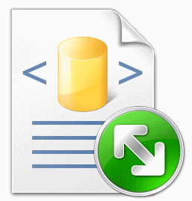

Executing Simple SQL Queries in SQL Server Management Studio
Live Demo

Slide 25

Moving an SQL Server Database

Slide 26
Moving a SQL Server Database
Necessary when we install a certain application at the customer environment
Ways of moving an SQL Server database:
By backup and restore
Create backup and restore it on the other server
By detaching and attaching the database files
The 2 servers must be the same versions!
By dumping the database as SQL script
Not supported in SSMS

Slide 27
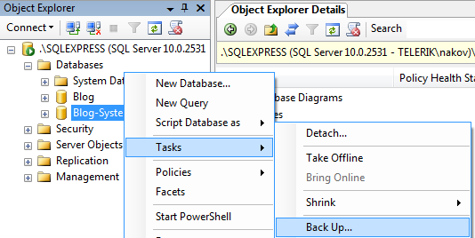
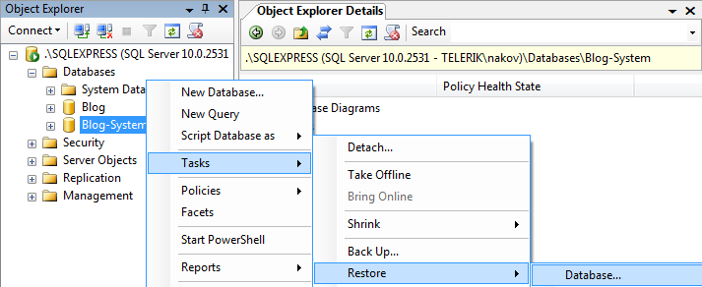
Moving by Backup and Restore
Backup and restore database through SSMS

Slide 28
Moving DB by Detaching and Attaching
On the source server:
Choose the database in SQL Server Management Studio
From the context menu we choose the Detach command
We copy the database files from the source server to the destination server:
<database_name>.mdf
<database_name>.ldf

Slide 29

Moving a Database by Detaching and Attaching
Live Demo

Slide 30
Introduction to SQL Server
http://academy.telerik.com

Slide 31
Exercises
Download and install SQL Server Express. Install also SQL Server Management Studio Express (this could take some effort but be persistent).
Connect to the SQL Server with SQL Server Management Studio. Use Windows authentication.
Create a new database Pubs and create new login with permissions to connect to it. Execute the script install_pubs.sql to populate the DB contents (you may need slightly to edit the script before).
Attach the database Northwind (use the files Northwind.mdf and Northwind.ldf) to SQL Server and connect to it.

Slide 32
Exercises (2)
Backup the database Northwind into a file named northwind-backup.bak and restore it as database named North.
Export the entire Northwind database as SQL script. Use [Tasks] -> [Generate Scripts]. Ensure you have exported table data rows (not only the schema).
Create a database NW and execute the script in it to create the database and populate table data.
Detatch the database NW and attach it on another computer in the training lab. In case of name collision, preliminary rename the database.

Slide 33




Free Trainings @ Telerik Academy
C# Programming @ Telerik Academy
csharpfundamentals.telerik.com
Telerik Software Academy
academy.telerik.com
Telerik Academy @ Facebook
facebook.com/TelerikAcademy
Telerik Software Academy Forums
forums.academy.telerik.com

